Slide 1

ENGINEERING MECHANICS
UNIT-II Chapter – 5
STATIC FRICTION
Basanagouda I Patil
Assistant Professor
School of Civil Engineering

Slide 2
What is Friction?
When a body slide or tend to slide on a surface it is resting , a resisting force opposing the motion is produced at the contact surface. This resisting force is called friction or frictional force.
Motion
Block
Applied force P
Rough floor
Frictional force F

Slide 3
In the absence of friction, it would be impossible for us to walk, ride a vehicle or pick some object from floor.
In some cases frictional force causes energy loss, which leads to wear & tear of components which are in contact. In such cases frictional force must be reduced.
To reduce friction, lubricants are used in machines.
Fine powder on the carrom board reduces friction.
Thus,
“Friction can be our friend or it can be an evil depending upon the circumstance”

Slide 4
Types of friction
In general, friction can be classified as :
Dry Friction: It is the force that opposes motion of one solid surface sliding across another solid surface which are in contact.
Fluid friction: It is the force that resists motion either within the fluid itself or of another medium moving through the fluid.

Slide 5
Further Dry Friction is classified into following two types
Static friction
Dynamic friction
Sliding friction
Rolling friction

Slide 6
1. Static friction
Friction experienced by the body when it is at rest is called static friction.
Here applied force is less than the limiting friction, hence the body remains at rest.
Ex: Pushing the wall.
Limiting friction
The maximum friction force that can be developed at the contact surface, when body is just on the point of moving is called as limiting friction.
Applied Force P
No
Motion
Static friction F

Slide 7
Small horizontal force P applied to block will produce static frictional force F and block remain stationary, in equilibrium.
As P increases, the static-frictional force F increases as well until it reaches a maximum value F_{m} which is limiting frictional force.
Further increase in P causes the block to begin to move as F drops to a smaller dynamic frictional force F_{k}. and it remains constant further.
Applied Force P
Frictional force F
F
F_{m}
F_{k}
O
Equilibrium
Motion
P

Slide 8

2. Dynamic friction (F_{k})
Friction experienced by the body when it is in motion is called dynamic friction.
Here applied force exceeds the limiting friction, hence the body starts moving over another body.
i. Sliding friction
Friction experienced by the body when it sides over the other body is called as sliding friction.
Ex: A person sliding down a slide.
.
Sliding Motion
Sliding friction

Slide 9
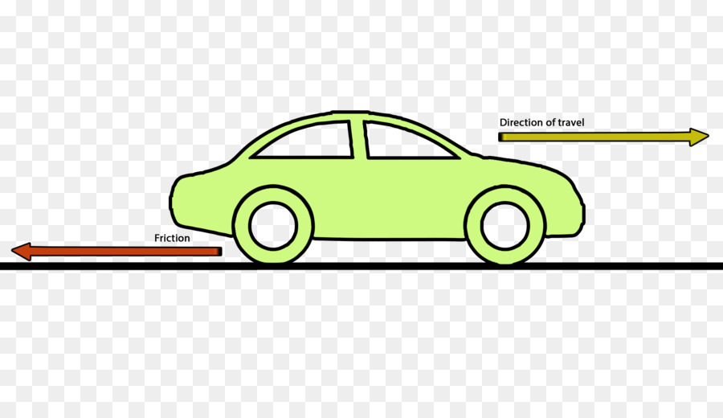
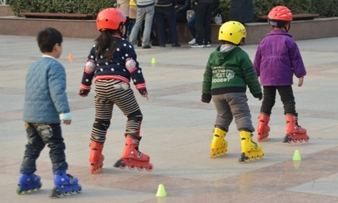
ii. Rolling friction
Friction experienced by the body when it rolls over the other body is called as rolling friction.
Ex: When car moves on the floor, wheels experience rolling friction.
Roller skates used for skating.
Rolling
Motion
Applied Force
Rolling friction

Slide 10
Coefficient of friction (µ):-
It is the ratio of limiting frictional force and the normal reaction between the objects. Mathematically it is expressed as;
Coefficient of friction = F/N
µ = F/N
Box
P
Rough floor
F
P = Applied force
F = Frictional force
N = Normal reaction
N

Slide 11
Laws of friction:
Coulomb conducted some experiments & the results of these experiments are known as laws of dry friction or Coulomb’s laws of friction.
The frictional force always acts in the direction opposite to that in which the body tends to move.
Till the limiting value is reached, the magnitude of frictional force is exactly equal to the applied force which tends to move the body.

Slide 12
3. The magnitude of liming friction bears a constant ratio to the normal reaction between the two surfaces of contact and this ratio is called coefficient of friction.
4. The force of friction depends on roughness or smoothness of the surfaces.
5. The force of friction is independent of the area of contact between the two surfaces.
6. After the body starts moving , the dynamic friction comes into play, the magnitude of which is less than that of liming friction and it bears a constant ratio with normal reaction. This ratio is called coefficient of dynamic friction.

Slide 13
Angle of Friction:
Consider a block subjected to pull ‘P’ as shown in the above figure. Let ‘F’ be the frictional force developed and ‘N’ be the normal reaction. At contact surface, the reactions are ‘F’ & ‘N’. These two reactions can be combined to get the resultant reaction ‘R’ which acts at angle ‘θ’ to the normal reaction.
W
P
F
θ
R
N

Slide 14
Thus, tanθ = F/N
As the frictional force increases, the angle θ increases & it can reach a maximum value ‘α’ when limiting value of friction is reached.
Thus, tanα = F_{m}/N = µ
Therefore, tanα = µ -----(a)
This value of ‘α’ is called as angle of friction.
The angle of friction is defined as that angle made by the resultant reaction ‘R’ with the normal component of reaction ‘N’ when friction reaches its maximum value..

Slide 15
Angle of Repose:
We know that when grains such as food grains, sand, cement, soil etc are heaped, there exists a limit for the inclination of the heap. Beyond which the grains starts rolling down. The limiting angle up to which the grains repose is called as angle of repose.
Consider a block of weight ‘W’ which is resting on an inclined plane which makes an ‘θ’ with the horizontal.
Wsinθ
W
F
θ
Wcosθ
θ
N

Slide 16
When ‘θ’ is small, block rests on an inclined plane. As ‘θ’ is increased gradually, at one particular stage, the block starts sliding. The angle made by the plane with the horizontal is called angle of repose for the contact surfaces. Thus “the maximum inclination of the plane on which a body free from external forces, can repose is called Angle of Repose”.
Now to prove that angle of repose is equal to limiting angle of friction consider equilibrium of block which is show in the above figure.

Slide 17
Applying equilibrium equations:
∑Fx= 0 i.e Forces parallel to plane = 0
F-Wsinθ = 0
F = Wsinθ -------- (i)
∑Fy= 0 i.e Forces normal to plane = 0
N - Wcosθ = 0
N = Wcosθ ------- (ii)

Slide 18
Let ϕ be the value of ‘θ’ such that the maximum frictional force F_{m} is called into play. and the motion is impending hence
tanϕ = F_{m}/N
tanϕ = Wsinϕ/ Wcosϕ = µ
tanϕ = µ ------(b)
From (a) and (b) we have tanα = tanϕ
=> α = Φ
Thus value of limiting angle of friction is same as the angle of repose

Slide 19
W
Cone of friction:
When the body is having impending motion in the direction of applied force ‘P’, the frictional force will be limiting friction & the resultant reaction ‘R’ will make limiting frictional angle α with the normal reaction.
If the body is having impending motion in some other direction, the resultant reaction ‘R’ will make limiting frictional angle α with the normal reaction.
P
F
α
α
R
N

Slide 20
Thus, if the direction of force ‘P’ is gradually changed through 360⁰, the resultant ‘R’ generates a right circular cone with semi central angle equal to ‘α’.
If the resultant reaction ‘R’ lies on the surface of this inverted cone whose semi central angle is limiting frictional angle ‘α’ the motion of the body is impending. If the resultant is within this cone the body is stationary. This inverted cone with semi central angle equal to limiting frictional angle ‘α’ is called Cone of Friction.

Slide 21
Problem 1.0
A body of weight W = 500 N is pulled up an inclined plane by a force of P = 350 N. The inclination of the plane is θ = 30⁰ to the horizontal & the force is applied parallel to the plane. Determine the coefficient of friction.
P
θ

Slide 22
Solution:
Let us first draw the Free body diagram (FBD) and understand different forces and reactions acting on the block.
+Y
+X
W = 500 N
FBD
P = 350 N
-X
-Y
500sinθ
F
θ
θ
N
500cosθ
W = 500 N

Slide 23
Since the applied force is pulling the bock up the plane it is at impending motion. Resolving forces in X and Y directions.
∑Fx= 0
P – F – 500sinθ = 0
350 – F – 500sin30 = 0
F = 100 N
∑Fy= 0
-500cos30 + N = 0
N = 433.012 N
At limiting equilibrium condition
Coefficient of friction, µ = F/N
µ = 100/433.012
µ = 0.2309
W = 500 N
P = 350 N
F
θ
N

Slide 24
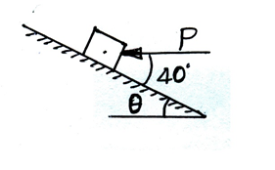
Problem 2.0
The coefficient of friction between 20 kg block and incline are µ_{S} = 0.4 and µ_{K} =0.3. Determine whether the block is in equilibrium if P= 400 N & θ =30° as shown and find the magnitude & direction of friction force.

Slide 25
Solution:
Let us first draw the Free body diagram (FBD) and understand different forces and reactions acting on the block.
FBD
P
40⁰
30⁰
N
196.2 N

Slide 26
FBD
Net force acting along the plane,
196.2sin30 – 400cos40
= -208.31 N (acting up the plane)
Hence the body is having tendency to move up the plane.
For equilibrium frictional force required is F_{req} = 208.31 N acting
Down the plane.
Net force acting perpendicular to the plane,
-196.2cos30 – 400sin40 + N = 0
N = 427 N
Frictional force at limiting equilibrium condition is
F_{m}= µ_{s}N
F_{m}= 0.4*427
= 170.80 N
Since F_{m}< F_{req} the block will not be in equilibrium and is moving up the plane.
Hence, the frictional force during the motion, F_{k} = µ_{k}N = 0.3 * 427 = 128.10 N down the plane.
P
40⁰
30⁰
N
196.2 N

Slide 27
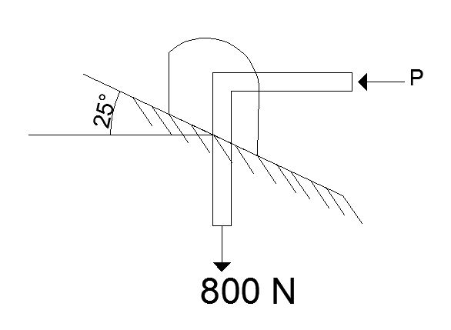
Problem 3.0
A block is acted upon by two forces as shown. Knowing that the coefficients of friction between the block and the incline are µ_{S} = 0.35 and µ_{K} =0.25, determine the force P required (a) to start the block moving up the incline, (b) to keep it moving up, (c) to prevent it from sliding down.

Slide 28
Solution: (a) to start the block moving up the incline
Let us first draw the Free body diagram (FBD) and understand different forces and reactions acting on the block.
FBD
800sin25
-X
+Y
motion
25⁰
800cos25
25⁰
+X
P
800 N
25⁰
-Y
F
Pcos25
25⁰
25⁰
P
N
800 N
Psin25

Slide 29
FBD
motion
The body is in static condition hence F_{m} = µ_{s}N
∑Fx= 0
F + 800sin25 – Pcos25 = 0
F = Pcos25 – 800sin25
WKT F = µ_{s}N = 0.35N
0.35N = Pcos25 – 800sin25 --------(i)
∑Fy= 0
N – 800cos25 – Psin25 = 0
25⁰
P
25⁰
Pcos25
25⁰
25⁰
F
N
800 N
Psin25
800sin25
25⁰
800cos25
800 N

Slide 30
FBD
motion
N = 800cos25 + Psin25 -----(ii)
Substituting (ii) in (i)
0.35[800cos25 + Psin25] = Pcos25 – 800sin25
0.758P = 591.86
P = 780.82 N
25⁰
P
25⁰
25⁰
F
N
800 N

Slide 31
(b) To keep it moving up:
Since body is moving up, coefficient of dynamic friction should be considered.
F_{k} = µ_{k}N
FBD
800sin25
-X
+Y
motion
25⁰
800cos25
25⁰
+X
P
800 N
25⁰
-Y
F
Pcos25
25⁰
25⁰
N
800 N
Psin25

Slide 32
FBD
motion
∑Fx= 0
F + 800sin25 – Pcos25 = 0
F = Pcos25 – 800sin25
WKT F = µ_{k}N = 0.25N
0.25N = Pcos25 – 800sin25 --------(i)
∑Fy= 0
N – 800cos25 – Psin25 = 0
25⁰
P
25⁰
Pcos25
25⁰
25⁰
F
N
800 N
Psin25
800sin25
25⁰
800cos25
800 N

Slide 33
FBD
motion
N = 800cos25 + Psin25 -----(ii)
Substituting (ii) in (i)
0.25[800cos25 + Psin25] = Pcos25 – 800sin25
0.8P = 519.351
P = 649.188 N
25⁰
P
25⁰
25⁰
F
N
800 N

Slide 34
(c) To prevent it from sliding down:
To prevent it from sliding down means the block should be under static condition.
F_{m} = µ_{s}N
FBD
800sin25
-X
+Y
motion
25⁰
800cos25
25⁰
+X
F
P
800 N
25⁰
-Y
Pcos25
25⁰
25⁰
N
800 N
Psin25

Slide 35
FBD
motion
∑Fx= 0
-F + 800sin25 – Pcos25 = 0
F = 800sin25 - Pcos25
WKT F = µ_{s}N = 0.35N
0.35N = 800sin25 - Pcos25 --------(i)
∑Fy= 0
N – 800cos25 – Psin25 = 0
25⁰
F
P
25⁰
Pcos25
25⁰
25⁰
N
800 N
Psin25
800sin25
25⁰
800cos25
800 N

Slide 36
FBD
motion
N = 800cos25 + Psin25 -----(ii)
Substituting (ii) in (i)
0.25[800cos25 + Psin25] = 800sin25 - Pcos25
1.054P = 84.328
P = 80 N
25⁰
F
P
25⁰
25⁰
N
800 N

Slide 37
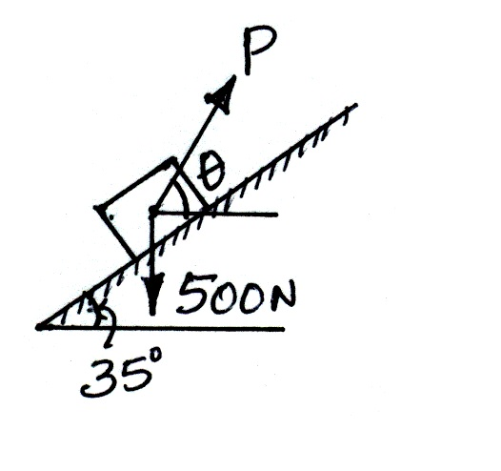
Problem 4.0
The coefficients of friction between the block and the rail are µ_{S} = 0.3 & µ_{K} =0.25. Find the magnitude and direction of the smallest force P required to (i) start the block up the rail and (ii) to keep it from moving down.

Slide 38
Solution: Case(i) to start the block moving up the incline
Considering the limiting equilibrium, the FBD of block is as shown. Since the motion impends up the plane the frictional force acts down the plane.
motion
FBD
+Y
P
500sin35
+X
(θ – 35⁰)
-X
35⁰
-Y
500cos35
F_{A}
500
35⁰
35⁰
N
500 N

Slide 39
motion
FBD
+Y
Resolving the forces perpendicular to the plane,
∑Fy= 0
N – 500cos35 + Psin(θ – 35⁰) = 0
N = 409.57 - Psin(θ – 35⁰)
But F = µ_{s}N = 0.3[409.57 - Psin(θ – 35⁰)]
F = 122.87 – 0.3Psin(θ – 35⁰) --------(i)
Resolving the forces along the plane,
∑Fx= 0
Pcos(θ – 35⁰) - F – 500sin35 = 0
Therefore, Pcos(θ – 35⁰) - 122.87 + 0.3Psin(θ – 35⁰) -286.79 = 0
P
+X
(θ – 35⁰)
-X
-Y
F
35⁰
35⁰
N
500 N
500sin35
35⁰
500cos35
500

Slide 40
motion
FBD
P[cos(θ – 35⁰) + 0.3sin(θ – 35⁰)] = 409.66
P = 409.66/[cos(θ – 35⁰) + 0.3sin(θ – 35⁰)] ----(A)
For P to be minimum, cos(θ – 35⁰) + 0.3sin(θ – 35⁰)
Should be maximum i.e
d/dθ [cos(θ – 35⁰) + 0.3sin(θ – 35⁰)] = 0
Therefore -sin(θ – 35⁰) + 0.3cos(θ – 35⁰) = 0
sin(θ – 35⁰)/cos(θ – 35⁰) = 0.3
tan(θ – 35⁰) = 0.3
θ = 51.7⁰
P
(θ – 35⁰)
F
35⁰
35⁰
N
500 N
500sin35
35⁰
500cos35
500

Slide 41
motion
FBD
From (A)
P_{min} = 409.66/[cos(16.7⁰) + 0.3sin(16.7⁰)] = 392.38 N
P_{min} = 392.38 N
P
(θ – 35⁰)
F
35⁰
35⁰
N
500 N
500sin35
35⁰
500cos35
500

Slide 42
Case (ii) to keep it from moving down
Since the block tends to move down the plane, the frictional force will be acting up the plane. i.e µ_{S} = 0.3
motion
FBD
+Y
P
500sin35
+X
(θ – 35⁰)
-X
F_{A}
35⁰
-Y
500cos35
500
35⁰
35⁰
N
500 N

Slide 43
motion
FBD
From case(i) F = 122.87 – 0.3Psin(θ – 35⁰)
Resolving the forces along the plane,
Pcos(θ – 35⁰) + F – 500sin35 = 0
Pcos(θ – 35⁰) + 122.87 - 0.3Psin(θ – 35⁰) -286.79 = 0
Pcos(θ – 35⁰) – 0.3Psin(θ – 35⁰) = 163.92
P[cos(θ – 35⁰) – 0.3sin(θ – 35⁰)] = 163.92-----(B)
For P to be minimum,
d/dθ [cos(θ – 35⁰) – 0.3sin(θ – 35⁰)] = 0
i.e -sin(θ – 35⁰) - 0.3cos(θ – 35⁰) = 0
tan(θ – 35⁰) = - 0.3
θ = 18.3⁰
P
(θ – 35⁰)
F_{A}
35⁰
35⁰
N
500 N
500sin35
35⁰
500cos35
500

Slide 44
motion
FBD
From (B)
P_{min} = 163.92/[cos(-16.7) – 0.3sin(-16.7)] = 157.0 N
P_{min} = 157.0 N
P
(θ – 35⁰)
F_{A}
35⁰
35⁰
N
500 N
500sin35
35⁰
500cos35
500

Slide 45
Problem 5.0
A body resting on a rough horizontal plane, required a pull of 180 N inclined at 30° to the plane just removed it. It was found that a push of 220 N inclined at 30° to the plane just removed the body. Determine the weight of the body and the coefficient of friction.

Slide 46
Solution: Let ‘W’ be the weight of body in N. When a pull of 180 N is applied, its FBD is as shown.
∑Fx= 0
180cos30⁰ – F = 0
F = 155.88 N
∑Fy= 0
N + 180sin30⁰ – W = 0
N = W – 90
But F = µN
155.88 = µ(W – 90) -----(i)
W
FBD
180 N
30⁰
F
N

Slide 47
When a push of 220 N is applied
∑Fx= 0
F - 220cos30⁰ = 0, F = 190.52 N
∑Fy= 0
N - 220sin30⁰ – W = 0
N = W +110 But F = µN
190.52 = µ(W + 110) -----(ii)
Dividing (i) by (ii)
(155.88 / 190.52) = µ(W – 90) / µ(W + 110)
0.818W + 90 = W – 90
0.181W = 180 or W = 989 N
Now from (ii) µ = 0.173
W
FBD
220 N
30⁰
F
N

Slide 48
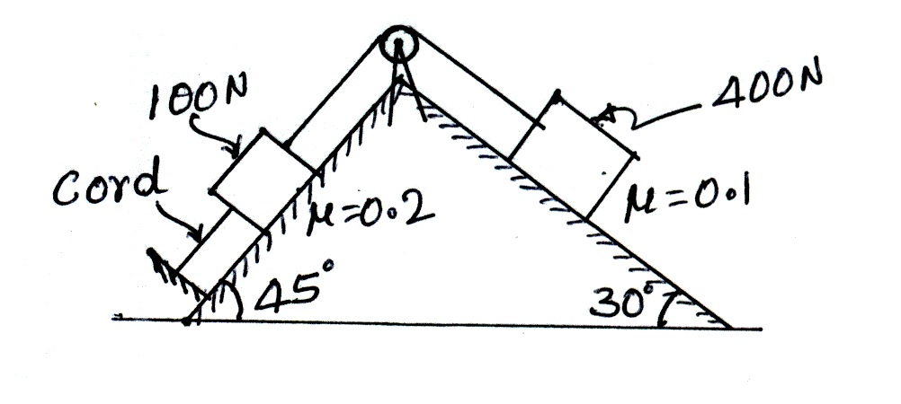
Problem 6.0
Find the maximum tension in the cord shown in figure, if the bodies have developed full friction.

Slide 49
Solution: for the tension to occur in the cord, 100 N block should move up the plane and 400 N block should move down the plane.
Considering the equilibrium of the block resting on 30⁰ incline plane its FBD is as shown.
FBD
400sin30
-X
+Y
T
motion
30⁰
400cos30
+X
F₁
400 N
-Y
30⁰
30⁰
N₁
400 N

Slide 50
FBD
Resolving all the forces perpendicular to the plane
N₁ – 400cos30 = 0
i.e N₁ = 346.41 N
Resolving all the forces along the plane
400sin30 – F₁ – T = 0
T = 165.36 N
T
motion
F₁
30⁰
30⁰
N₁
400 N

Slide 51
Now considering equilibrium of 100 N block, the tension in the cord T^{l} and frictional forces are shown in the figure.
motion
FBD
100sin45
T
45⁰
T¹
100cos45
F₂
100 N
45⁰
45⁰
N₂
100 N

Slide 52
Resolving all the forces perpendicular to the plane
N₂ – 100cos45 = 0
i.e N₂ = 70.70 N
Resolving all the forces along the plane
T – T^{l} – F₂ – 100sin45 = 0
But F₂ = µN₂ = 14.14 N
T¹ = 80.52 N
motion
FBD
T
T¹
F₂
45⁰
45⁰
N₂
100 N

Slide 53
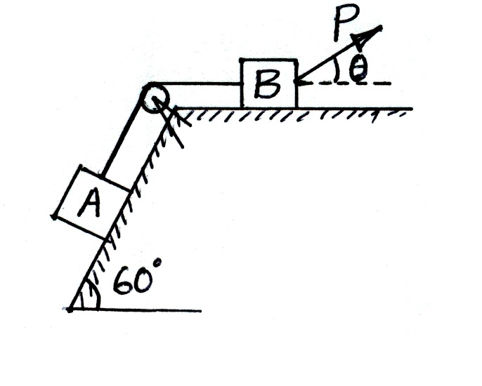
Problem 7.0
Two blocks A and B weighing 1500 N & 1000 N, and connected by a string passing over a smooth pulley, rest on a 60° inclined plane and a horizontal plane, the block B being subjected to an external force P as shown in figure. If the coefficient of friction be 0.25 under the blocks, find the least value of P to drag the block A up the plane.

Slide 54
Solution: Consider the equilibrium of block A. since it has tendency to move up the plane, frictional force acts down the plane. Let T_{A} be the tension in the string.
FBD of block A
motion
+Y
+X
T_{A}
1500sin60
-X
60⁰
-Y
1500cos60
F_{A}
1500
60⁰
60⁰
N_{A}
1500 N

Slide 55
FBD of block A
motion
Consider equilibrium of block A
Resolving the forces perpendicular to the plane
∑Fy= 0
N_{A} – 1500cos60 = 0
N_{A} = 1500cos60 = 750 N
WKT F_{A} = µ_{A}N_{A} = 0.25 * 750
F_{A} = 187.5 N
Resolving the forces parallel to the plane
∑Fx= 0
T_{A} - F_{A} – 1500sin60 = 0
T_{A} = 187.5 + 1500sin60
+Y
+X
T_{A}
-X
-Y
F_{A}
1500sin60
60⁰
60⁰
N_{A}
60⁰
1500 N
1500cos60
1500 N

Slide 56
FBD of block A
motion
T_{A} = 187.5 + 1299
T_{A}= 1486.5 N
+Y
+X
T_{A}
-X
-Y
F_{A}
W_{A}sin60
60⁰
60⁰
N_{A}
60⁰
W_{A}
W_{A}cos60
W_{A}

Slide 57
FBD of block B
1000 N
motion
P
T_{A}
θ
F_{B}
P
Psinθ
N_{B}
θ
Pcosθ

Slide 58
FBD of block B
1000 N
motion
Consider equilibrium of block B
Resolving the forces parallel to the plane
∑Fx= 0
-T_{A} - F_{B} + Pcosθ = 0
WKT F_{B} = µ_{B}N_{B}
-1486.5 – 0.25N_{B} + Pcosθ = 0 -----(i)
Resolving the forces perpendicular to the plane
∑Fy= 0
N_{B} – 1000 + Psinθ = 0
N_{B} = 1000 –Psinθ -----(ii)
P
T_{A}
θ
F_{B}
P
Psinθ
N_{B}
θ
Pcosθ

Slide 59
FBD of block B
1000 N
motion
Substituting (ii) in (i)
-1486.5 – 0.25(1000 – Psinθ) + Pcosθ= 0
Pcosθ+0.25Psinθ = 1736.54
Therefore P = 1736.5/(cosθ + 0.25sinθ)
For P to be minimum , (cosθ + 0.25sinθ) should be maximum
i.e, d/dθ (cosθ + 0.25sinθ) = 0
i.e – sinθ + 0.25cosθ = 0
Or sinθ = 0.25cosθ
P
T_{B}
θ
F_{B}
P
Psinθ
N_{B}
θ
Pcosθ

Slide 60
Or tanθ = 0.25
θ = 14.03⁰
P_{min} = 1736.5/(cosθ + 0.25sinθ)
P_{min} = 1684.65 N

Slide 61
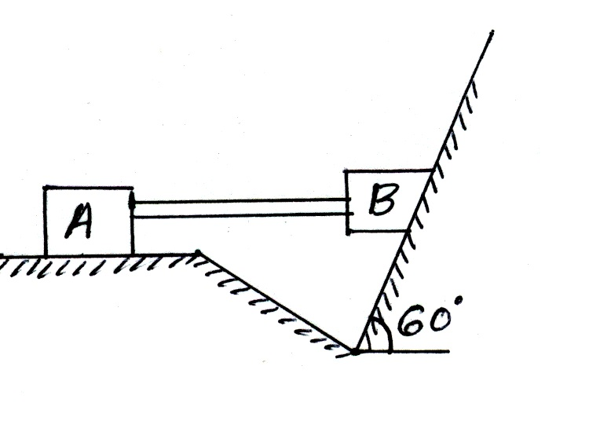
Problem 8.0
Two blocks A & B, connected by a horizontal rod by frictionless hinges, are supported on two rough planes as shown in figure. The coefficients of friction are 0.3 between block A and the horizontal surface & 0.4 between block B and the inclined surface. Block B weighs 1000 N. What is the smallest weight of block A that will hold the system in equilibrium ?

Slide 62
Solution: Since the block B has a tendency to move down the plane, frictional force acts up the plane. There will be reaction from block A through the rod. FBD of block B is as shown
FBD of block B
1000 N
F
R_{A}
N_{B}
60⁰

Slide 63
Resolving all the forces perpendicular to the plane
N_{B} – 1000cos60 – R_{A}sin60 = 0
i.e N_{B} = 500 + 0.866R_{A}
But F = µN_{B} = 0.4(500 + 0.866R_{A})
F = 200 + 0.3464R_{A}-----(i)
Resolving all the forces along the plane
F – 1000sin60 + R_{A}cos60 = 0
From (i) putting the value of F
200 + 0.3464R_{A}- 866 + 0.5R_{A} = 0
R_{A} = 786.86 N
FBD of block B
1000 N
F
R_{A}
N_{B}
60⁰

Slide 64
Considering equilibrium of block A its FBD is as shown in figure.
Let W be the weight of block A
Resolving all the forces perpendicular to the plane
∑Fy= 0
N_{A} = W
Resolving all the forces along the plane
∑Fx= 0
F = 786.86 N
But F = µN_{A}
786.86 = 0.3W
W = 2622.87 N
FBD of block A
W
motion
786.86 N
F
N_{A}

Slide 65
Problem 9.0
The coefficients of friction is 0.30 between all the surfaces of contact. Block C & D weigh 1000 N & 1500 N respectively. Determine the smallest force required to start block D moving if (i) Block C is restrained by cable AB as shown in figure.(ii) cable AB is removed.
A
B
C
D
P

Slide 66
Solution: Case(i) Consider the equilibrium of block C. when block D moves to the right, because of the cable AB. Block C moves to the left.
Hence the friction force acts to the right. If T is the tension
In AB, its FBD is as shown .
Applying ∑Fy= 0, N_{D} = 1000 N.
∑Fx= 0, F_{D} = T
µN_{D} = T
0.3 * 1000 = T
T = 300 N.
FBD of block C
1000 N
motion
T
F_{D}
N_{D}

Slide 67
FBD of block D
N_{D}+1500 N
motion
Consider the equilibrium of block D.
Applying ∑Fy = 0, N_{G} = 2500 N.
But F_{G} = µN_{G} = 0.3 * 2500 = 750 N
∑Fx= 0, P – 300 – F_{G} = 0
P = 300 + 750 = 1050 N
300 N
P
F_{G}
N_{G}

Slide 68
Case(ii) when cable AB is absent
Applying ∑Fy= 0, N_{G} = 2500 N.
But F_{G} = µN_{G} = 0.3 * 2500 = 750 N
∑Fx= 0,
P - F_{G} = 0
P = 750 N
FBD of block D
motion
2500 N
P
F_{G}
N_{G}

Slide 69
Application to ladder problems.
A ladder resting on ground and leaning against wall is a typical case of friction problem in non concurrent coplanar system. Here three equations of equilibrium are available,
∑Fx = 0; ∑Fy = 0; ∑M = 0.
From law of static friction we have µ = F/N
Thus using these three equations, problems on ladder is solved.

Slide 70
Problem 10
A ladder of length 4.0 m and weighing 200N is placed against a vertical wall as shown in figure. The coefficient of friction between the wall and the ladder is 0.2 and that between the floor and the ladder is 0.3. the ladder in addition to its own weight has to support a man weighing 600 N at a distance of 3.0 m from A. calculate the minimum horizontal force to be applied at A to prevent slipping.
600 N
B
4 m
3 m
2 m
60⁰
200 N
A

Slide 71
FBD
F_{B}
FBD of ladder is as shown in figure. Let P be the force to be applied at A.
∑M_{A}= 0,
200 * 2cos60 + 600 * 3cos60 – N_{B} * 4sin60 – F_{B} * 4cos60 = 0
But F_{B} = µN_{B} = 0.2 N_{B}
Therefore 200 + 900 – 3.464N_{B} - 0.4N_{B} = 0
3.864N_{B} = 1100 or N_{B} = 284.68 N
F_{B} = 0.2 * 284.68 = 56.93 N
∑Fy= 0, N_{A} + F_{B} – 200 – 600 = 0
N_{A} = 743.07 N
N_{B}
600 N
B
A
200 N
P
F_{A}
600 N
B
N_{A}
4 m
3 m
2 m
60⁰
200 N
A

Slide 72
FBD
F_{B}
∑Fx= 0, P + F_{A} - N_{B} –= 0
P = 284.68 – 0.3* 743.07 = 61.76 N
P = 61.76 N
N_{B}
600 N
B
A
200 N
P
F_{A}
N_{A}

Slide 73
Problem 11
A uniform ladder AB of length 3.0 m and weight 200 N rests with the end B against rough vertical wall and the end A on the level ground. If the wall and the ground are equally rough and the coefficient of friction is 0.5, find the limiting position of equilibrium.
B
3 m
1.5 m
200 N
θ
A

Slide 74
FBD
F_{B}
Let the ladder makes an angle θ with horizontal in limiting equilibrium condition.
FBD of the ladder is as shown
Applying ∑Fx = 0, F_{A} – N_{B} = 0 or F_{A} = N_{B}
But F_{A} = µN_{A}
therefore µN_{A} = N_{B}
N_{A} = N_{B} / 0.5 = 2N_{B} -----(i)
∑Fy = 0,
N_{A} – 200 + F_{B} = 0 or 2N_{B} + 0.5N_{B} = 200
N_{B} = 80 N
N_{B}
B
200 N
A
F_{A}
B
N_{A}
3 m
1.5 m
200 N
θ
A

Slide 75
FBD
F_{B}
Applying ∑M_{A}= 0,
200 * 1.5cosθ – N_{B} * 3sinθ – 0.5N_{B} * 3cosθ = 0
300cosθ – 240sinθ – 120cosθ = 0
180cosθ = 240sinθ
tanθ = 180/240 = 0.75
Therefore θ = 36.86⁰
The ladder will be in limiting equilibrium when it makes 36.86⁰
with horizontal.
N_{B}
B
200 N
A
F_{A}
B
N_{A}
3 m
1.5 m
200 N
θ
A

Slide 76
Problem
A ladder of length 4.0 m and weighing 200N is placed against a vertical wall as shown in figure. The coefficient of friction between the wall and the ladder is 0.2 and that between the floor and the ladder is 0.3. the ladder in addition to its own weight has to support a man weighing 600 N at a distance of 3.0 m from A. calculate the distance x measured along the ladder from A at which horizontal force P = 80 N to be applied at A to prevent slipping.
600 N
B
4 m
3 m
2 m
P = 80 N
x
60⁰
200 N
A

Slide 77
FBD
F_{B}
∑Fx= 0, 80 + F_{A} – N_{B} = 0
F_{A} – N_{B} = - 80
0.3 N_{A} - N_{B} = - 80 ------(i)
∑Fy= 0, N_{A} + F_{B} – 200 – 600 = 0
N_{A} + F_{B} = 800
N_{A} + 0.2 N_{B}= 800 ------(ii)
Solving (i) & (ii) we get
N_{A} = 739.62 N & N_{B} = 301.88 N
N_{B}
600 N
B
80 N
200 N
A
F_{A}
N_{A}

Slide 78
FBD
F_{B}
F_{A} = 0.3 * 739.62 = 221.88 N
F_{B} = 0.2 * 301.88 = 60.37 N
∑M_{A}= 0,
200 * 2cos60 + 600 * 3cos60 – N_{B} * 4sin60 – F_{B} * 4cos60
+ 80 * xsin60= 0
Therefore 200 + 900 – 1045.74- 120.74 + x80sin60 = 0
x = 66.48/(80sin60)
x = 0.96 m
N_{B}
600 N
B
80 N
200 N
A
F_{A}
N_{A}
600 N
B
4 m
3 m
2 m
P = 80 N
x
60⁰
200 N

Slide 79
Applications to wedge problems
Wedges are small piece of hard materials with two of their opposite surfaces are not parallel to each other. They are used to slightly lift heavy blocks, machinery, precast beams etc. for making final alignment or to make place for inserting lifting devices.
Here weight of the wedge is small compared to the weight lifted. Hence in all the problems weight of the wedge is neglected, unless it is specified.
In the analysis instead of considering normal reaction & frictional force independently, it is advantageous to take the resultant of these two forces.

Slide 80
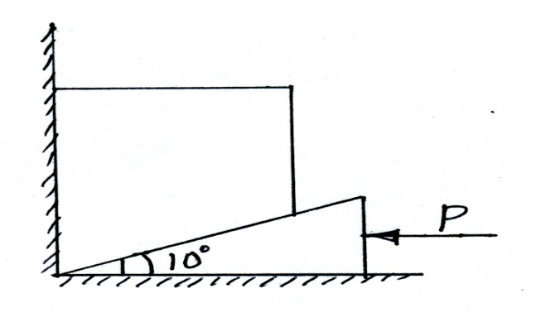

W
Block
F₁
If ‘F’ is the limiting friction, ‘N’ be
the normal reaction, then ‘R’ will
be the resultant making limiting
Angle of friction $′θ′$with the normal.
R₁
θ
N₁
F₂
θ
Wedge
R₂
N₂
R₂
P
F₃
θ
R₃
N₃

Slide 81
Problem 12
A block weighing 1500 N is to be raised by means of a 10° wedge. Assuming the coefficient of friction between all the contacting surfaces to be 0.30, determine what minimum horizontal force P should be applied to raise the block?

Slide 82
FBD
1500 N
Solution: Coefficient of friction µ = 0.3
At limiting equilibrium tanθ = µ
tanθ = 0.3
θ = 16.69⁰
Consider the equilibrium of block when the wedge
is pushed inside, the block slides upwards & towards right also
FBD of block is as shown.
R₁ makes an angle θ with horizontal & R₂ makes an angle (θ + 10) = 26.69⁰
with vertical.
Since the three forces are concurrent we can apply Lami’s theorem to get R₁ & R₂
F₁
R₁
θ
N₁
F₂
θ
R₂
N₂
R₂
26.69⁰
16.69⁰
R₁
1500 N

Slide 83
FBD
1500 N
R₁/sin(180-26.69) = R₂/sin(90-16.69) = 1500/sin(90+26.69+16.69)
R₁/sin(153.31) = 1500/sin(133.38)
R₁ = 926.98 N
R₂/sin(73.39) = 1500/sin(133.38)
R₂ = 1976.97 N
F₁
R₁
θ
N₁
F₂
θ
R₂
N₂
R₂
26.69⁰
16.69⁰
R₁
1500 N

Slide 84
FBD
Now consider the equilibrium of wedge
R₂/sin(90+16.69) = R₃/sin(90+26.69) = P/sin(180-26.69-16.69)
1976.97/sin(106.69) = P/sin(136.62)
P = 1417.56 N
R₂
26.69⁰
P
F₃
θ
R₃
N₃
R₃
16.69⁰
P
26.69⁰
R₂

Slide 85
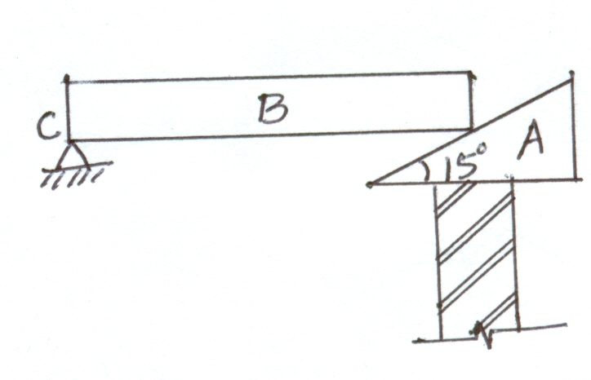
Problem 13
One end of a beam B, of uniform cross section weighing 1200 N is hinged & the other end is lifted by a 15° wedge. The lower face of the wedge A is horizontal on a horizontal support. The coefficient of friction is 0.36 at the upper surface of the wedge & is 0.25 at the lower surface. Find the horizontal force required to push the wedge under the beam.

Slide 86
FBD
Solution: On the upper surface of the wedge, µ₁ = 0.36 = tanϕ₁
ϕ₁ = 19.79⁰
On lower surface of the wedge, µ₂ = 0.25 = tanϕ₂
ϕ₂ = 14.03⁰
Consider the equilibrium of beam. The reaction of wedge R₁ on the beam makes an angle of 19.79⁰+ 15⁰ = 34.79⁰ with vertical as shown in FBD.
∑M_{c}= 0, 1200 * (l/2) - R₁cos34.79⁰ * l = 0
R₁ =600/cos34.79⁰ = 730.30 N
1200 N
l
C
F₁
R_{cx}
15⁰
ϕ₁
R₁
R_{cy}
N₁

Slide 87
FBD
Now Consider the equilibrium of wedge. FBD is as shown,
Applying Lamis’s theorem
R₂/sin(90+34.79) = 730.6/sin(90+14.03) = P/sin(180-34.79-14.03)
R₂/sin(90+34.79) = 730.6/sin(90+14.03)
R₂ = 618.44 N
730.6/sin(90+14.03) = P/sin(180-34.79-14.03)
P = 566.78 N
730.6 N
34.79⁰
P
15⁰
14.03⁰
R₂
R₂
14.03⁰
P
34.79⁰
_{730.6}

Slide 88
Problem
Determine the horizontal force P to start 4000 N wedge, to the right. The angle of friction is 20⁰ at all the contact surfaces. Refer fig. also find the reaction from inclined surface.

Slide 89
Problem 2.0
A force P = 350 N acts as shown on the block of weight W = 500 N which is resting on an inclined plane. The coefficients of friction between block and inclined plane are µ_{s}= 0.4 & µ_{k}= 0.3 Determine whether the block is in equilibrium and find the value of the frictional force. Take θ = 30⁰
P
θ

Slide 90
Solution:
Let us first draw the Free body diagram (FBD) and understand different forces and reactions acting on the block.
+Y
+X
W = 500 N
FBD
P = 350 N
-X
-Y
500sinθ
θ
θ
N
500cosθ
W = 500 N

Slide 91
Net force acting along the plane,
350 – 500sinθ
= 100 N (acting up the plane)
Hence the body is having tendency to move up the plane.
For equilibrium frictional force required is F_{req} = 100 N acting
Down the plane.
Net force acting perpendicular to the plane,
-500cos30 + N = 0
N = 433.01 N
Frictional force at limiting equilibrium condition is
F_{m}= µ_{s}N
F_{m}= 0.4*433.01
= 173.20 N
Since F_{m}> F_{req} the block will be in equilibrium.
value of the frictional force; F_{s} = 173.20 N and it acts in the downward direction.
W = 500 N
P = 350 N
θ
N

Slide 92
Thank You

